Slide 1
DMH Forensic Services Overview
Presented by:
John C. Barber, LICSW,
WESTERN MA Area Forensic Director, STATEWIDE COORDINATOR OF CIT-TTACs
EOHHS
Department of Mental Health
December 13th, 2023

Slide 2


DMH Forensic services overview
Jail/Arrest diversion Programs (CIT/CO-Response)
Court Clinics and court-ordered evaluations
Inpatient Forensic and other Specialized Evaluations*
Specialty court services
Forensic Transition Team (FTT)*
Notes:
Adult court clinics
Juvenile court clinics
Inpatient forensic evaluations
Forensic Transition Team (case managers)
Jail (arrest) diversion grant programs
MIPSB Evaluations (Mental Illness/Problematic Sexual Behavior)
DFP Certification and Training
Criminal History Systems linkage
Interagency collaboration
Inspection of Correctional Health Services in Segregation Units

Slide 3
DMH Forensic Services
DMH Forensic Mental Health Services (Forensic Services)
is involved at the intersection between behavioral health and across multiple points in the justice system

Slide 4
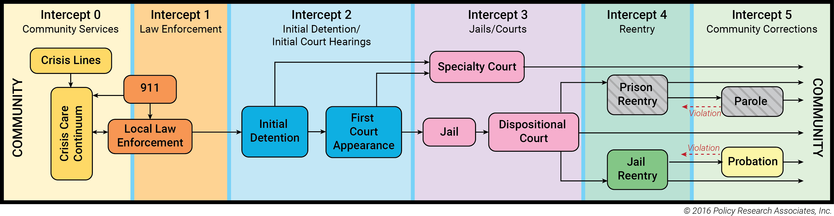
Mental Health and Substance Abuse Intercepts in the Criminal Justice Process: A Broad Overview
Notes:
Sheila, manic episode, takes a soda and a bag of potato chips without paying for it from the Cumberland Farms because she believes she owns the store!

Slide 5
Police-Based Jail Diversion
Early intercept focus
DMH Funding for Police-Based Diversion began in 2007
DMH currently funds OVER 120 + JDP’s (Jail Diversion Programs) in MA impacting OVER 210 CITIES and towns
CBHC’s are key partners – §12 merry-go-round vs. warm handoff?
Example

Slide 6
Jail Diversion Program Types
Crisis Intervention Team: Community initiatives that are law enforcement led
Police-based clinician
Co-Responses
Follow up responses
TTACs: Training and Technical Assistance Centers
Crisis Intervention Team
Co-response
Notes:
And Other New JDP Projects…

Slide 7
Why Jail Diversion Matters
Disproportionate percentage of people with SMI (serious mental illness) in jail: about 14.5% of males, 31% of females
1 in 16 people have a SMI, but people with SMI are 3-4x as likely to be in jail
Opportunity to engage with treatment through probation and specialty court services
Case Example
Notes:
https://csgjusticecenter.org/wp-content/uploads/2014/12/Prevalence-of-Serious-Mental-Illness-among-Jail-Inmates.pdf
Steadman et al. 2009 Psychiatric Services

Slide 8
Co-Response Impacts
Use of police-based co-response clinicians result in:
1) Less use of ER’s
2) Psychiatric situations being resolved at the scene
3) Less arrests, more diversions into treatment appropriate services
4) Less time that officers need to wait for clinicians/mental health response.

Slide 9
Public Safety
People with MI much more likely to be victims than perpetrators of violence
Skillful intervention and finding appropriate options for treatment may be more effective AND require less time
Less use of force and more focus on effective de-escalation techniques and approaches that manage, not inflame the crisis
People with untreated mental illness are 16x more likely to be fatally shot by law enforcement during an encounter
Notes:
Police shooting issue: between 25-50% of those fatally shot by police have a hx of SMI.
TAC article: https://www.treatmentadvocacycenter.org/key-issues/criminalization-of-mental-illness/2976-people-with-untreated-mental-illness-16-times-more-likely-to-be-killed-by-law-enforcement-

Slide 10
DMH Grant Supported Police Officer Training FY 16-23

Slide 11
CIT Training Results
Studies indicate that CIT Training develops increased confidence among police officers 1,2
CIT Officers have very efficient crisis response times
Increased diversions from arrest among those with mental illness
Improves treatment continuity
significantly decreases police officer injury rates
1.Compton et al. “A Comprehensive Review of Extant Research on Crisis Intervention Team (CIT) Programs” J Am Academy Psychiatry Law 36:1:47-55 (March 2008)
2. http://www.citinternational.org/training-overview/163-memphis-model.html

Slide 12
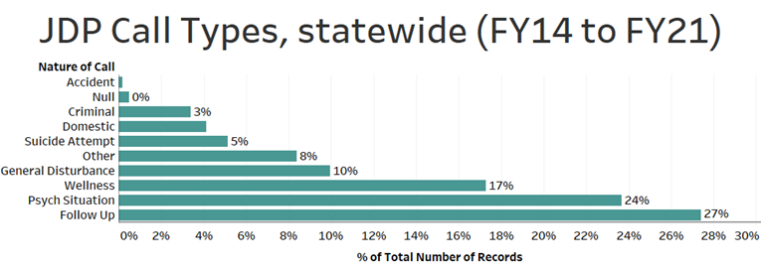
JDP Call Types
Notes:
Not much variability year to year. Follow-up, psych situations, wellness checks and general disturbances lead the types of incidents that JDP’s are involved with, while actual criminal situations are a tiny percentage 2-3%.

Slide 13
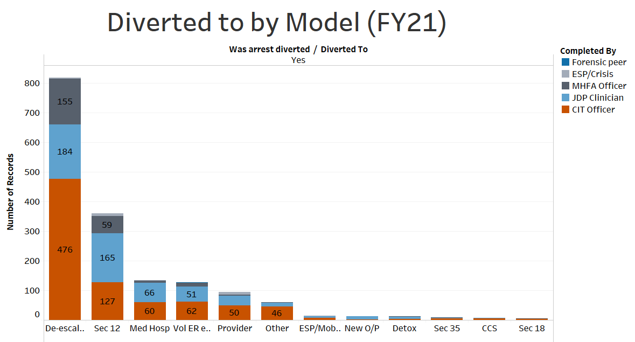
Notes:
Most arrest diversions occur through use of de-escalation techniques and strategies, mostly through CIT and MHFA trained officers. Section 12’s, medical hospitalizations, and voluntary hospitalizations are also used as diversions to arrest.

Slide 14
WM DMH JDP Grantees
WM CIT-TTAC (CIT Training &Technical Assistance Center)
Current Police Department Awardees: Amherst, ASHFIELD REG., Belchertown, Chicopee, DEERFIELD, Easthampton/Hadley, ERVING REG., Granby, GREENFIELD, GReenfield REGional, Holyoke, Longmeadow, MONTAGUE, Northampton, South Hadley, SOUTH HADLEY REG, Springfield, SUNDERLAND REG., Ware, Westfield, Wilbraham
Other WM Communities Involved with CIT Training: E. Longmeadow, Great Barrington, Hampshire County Sheriff Dept, Hatfield, UMASS, W. Springfield, AND…MANY MORE!
Notes:
*Now partnering with their Fire Departments.

Slide 15
COURT CLINICS
And court-ordered evaluations

Slide 16
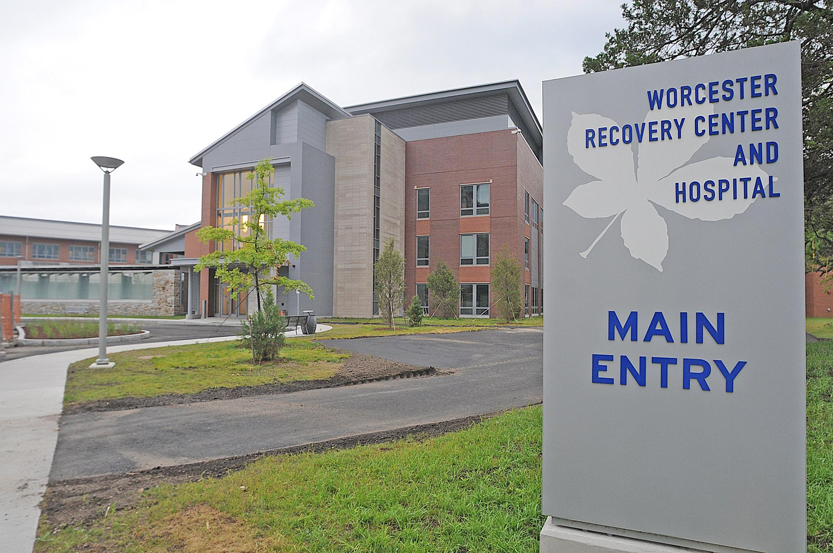

Court clinics are the “emergency room” of state forensic mental health evaluations
Notes:
No longer treaters of last resort – courts/judges frequently see their role as providing treatment solutions for those that are justice involved.

Slide 17
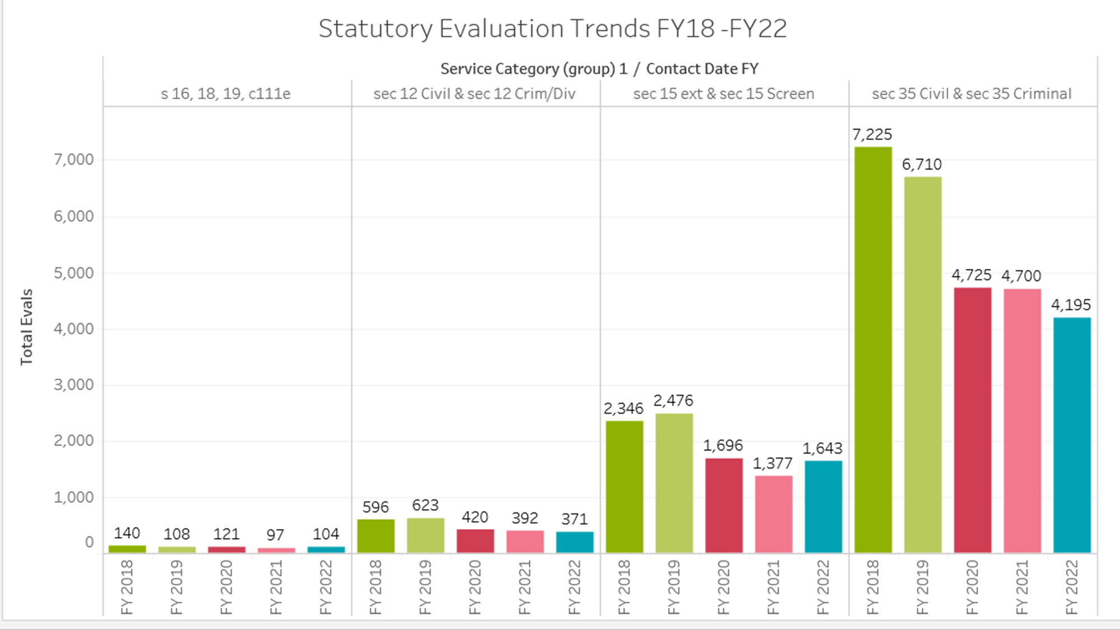

Slide 18
Court Clinic Evaluations
WM Provider: BHN
Evaluations are completed by:
DFP’s (Designated forensic professionals)
QSW’s (Qualified social workers)
CJCC (Certified Juvenile court Clinicians)
12e’s turn into 12a’s at court.
Notes:
§12e’s – Any family member or concerned party can petition the court for person to be civilly committed to a psychiatric hospital.
12e’s are fairly rare – courts are treaters of last resort, almost always converted to 12a’s
*One State Court Clinician in WM

Slide 19
Types of WM Court Ordered Evaluations Completed, FY 23
Notes:
Note Springfield, Pittsfield and Holyoke activity.

Slide 20
MGL Chapter 123, §15a and §15b
§15a screening– Outpatient Competency to Stand Trial (CST) or Criminal Responsibility (CR) evaluations
§15b – Inpatient Commitment for evaluation purposes (CST and/or CR) – 20 to 40 days

Slide 21
Legal Basis For Competency to Stand Trial
In Massachusetts, a defendant is found competent to stand trial if he has "sufficient present ability to consult with his lawyer with a reasonable degree of rational understanding, and if he has a rational as well as factual understanding of the proceedings against him"
(Commonwealth v. Vailes, 1971)
Notes:
NOTE: Discuss that: The defendant should be able to participate meaningfully in his trial by consulting with his lawyer and participating rationally in making decisions such as how to plead, what evidence to present at trial, and whether to testify in his own defense.

Slide 22
Why Does Competency Matter?
Case example
What happens if someone is found incompetent?
What if the defendant remains incompetent?
Notes:
An important principle of the criminal justice system is that a person must be competent to stand trial before he can be tried. This ensures:
Fairness
Integrity and Accuracy
Dignity.

Slide 23
CST and CR Timelines
Competency reports look at whether the accused individual is competent now : can be found Incompetent to Stand Trial and then later found CST
Criminal Responsibility looks at the mental status at the time of the crime
Example of CR case

Slide 24
NGI: Not Guilty By Reason of Insanity
What percentage of cases use NGI defense?
Less than 0.1% and only 25% succeed
What happens when someone is found NGI? Where do they go?
Why are there so few NGI’s?
Public perception vs. reality
Notes:
The Not Guilty By Reason of Insanity defense is reserved for the most seriously impaired defendants and only used for those with serious offenses. Most defendants with a mental illness are considered criminally responsible for their behavior. Note that NGI can only be used as a defense after someone is found competent.
Contrary to popular belief, this defense is invoked in only about 1/10 of 1% of all felony cases (that is, one in every thousand cases). Furthermore, even when a defendant uses this plea, he or she is likely to succeed only about one-quarter of the time.

Slide 25
NGI Criteria
Massachusetts legal criteria for being found NOT criminally responsible:
Inability to appreciate wrongfulness due to mental illness or mental defect at the time of the crime
Inability to conform conduct due to mental illness or mental defect at the time of the crime
Notes:
The Insanity Defense and its Underlying Principle
The "Not Guilty by Reason of Insanity" defense is well-grounded in American and English law, and indeed has been used for over 2,000 years, as there are references to such a concept in both Greek culture and ancient Jewish law.
The basic principle is that in order to be convicted of a crime, a defendant must have both committed an act that is considered against the law and also must have done so with a guilty state of mind.
Massachusetts Legal Standard
In Massachusetts the legal standard for determining whether a defendant will be found Not Guilty by Reason of Insanity was established in a 1967 case, Commonwealth v. McHoul.
The standard adopted is that a defendant is found not criminally responsible if, at the time of engaging in a particular act, “as a result of mental disease or defect [the defendant] lacks the substantial capacity either to appreciate the criminality [wrongfulness] of his conduct or to conform his conduct to the requirements of the law.” In Massachusetts, this standard is known as the McHoul test.

Slide 26
Forensic Hospitalization
Where do people go when they are forensically hospitalized?
How long are they hospitalized for?
Where do they go when they complete a forensic hospitalization?
Why are some MI people hospitalized after a crime, and some are not? Does that occur before or after sentencing?

Slide 27
DMH Inpatient Units
Solomon Carter Fuller (SCF), Boston
Worcester Recovery Center and Hospital (WRCH)
Hawthorne Mental Health Units, Tewksbury State Hospital
Metro Boston Mental Health Units at Lemuel Shattuck Hospital (LSH)
(contracted) Mtn. View/Valley Springs (Holyoke)
Taunton State Hospital

Slide 28
DMH Adult Inpatient
Age 19 and over
Evaluation and commitment for treatment
Forensic cases comprise nearly all admissions
Civil and voluntary patients
Pre-arraigned prisoners in police custody via sec.18(a)

Slide 29
WM Forensic Hospitalizations and Placements, FY 23
Notes:
FY23: 228 Overall Forensic Hospitalizations, 58 at BSH, and 32 18a’s
FY 22: 193 Overall Forensic Hospitalizations, 64 at BSH and 31 18a’s.
FY 21: 147 Overall Forensic Hospitalizations, 57 at BSH and 21 s.18’s.

Slide 30
Section 16’s
§16 (a): Court ordered inpatient evaluation of a criminal defendant after a finding of incompetence to stand trial (IST) or not guilty by reason of insanity
§16(b) and §16(c): Court ordered commitment for continued treatment of a person who has previously been found either IST or NGI. Need to be deemed a risk to self or others
§16(b) commitment – up to 6 months; §16(c) commitment– up to 1 year
Periodic competency re-evaluations (§17a)
Notes:
For 16a’s: They are court ordered evaluation to determine need for further treatment.
Duration is up to 40 days itself, or up to 50 days if it follows a §15(b)
AGAIN: WHAT HAPPENS TO THE DEFENDANT’S CASE IF THEY REMAIN INCOMPETENT? WHAT ARE THE COURTS OPTIONS?

Slide 31
Western MA Specialty Courts
Springfield Mental Health Court – Recovery With Justice; Greenfield Also HAS a Mental Health Court
Greenfield, Franklin Family Probate, Orange, Northampton, Hampshire probate and family, Pittsfield, and Springfield Drug Courts (BHN Vendor)
Veterans Specialty Court (serving Hampden, Hampshire, and Franklin Counties) at Holyoke District Court
Veterans Treatment Court: Soldier On is DMH-contracted provider
Notes:
Describe the role of the Specialty Court clinician: screen, assess, refer, and consult.

Slide 32
Specialty Court Key elements
Key elements to an effective program include:
intensive probation supervision
frequent drug testing
participation in treatment and therapeutic activities
careful monitoring of progress by the Judge and specialty session team
Personal accountability

Slide 33
§18a Transfer
§18: Transfer of Prisoners in Need of Hospitalization by Reason of Mental Illness:
Court-ordered inpatient evaluation or commitment of a prisoner in need of treatment
Most go to BSH and require strict security as they are incarcerated
Women prisoners come to DMH facilities
Notes:
WM:
WM: MEAN 11-YEAR ADMISSIONS 5.8 Berkshire 1.5 Franklin 20.1 Hampden 6.8 WCC 6.7 Hampshire HOC 36.6 Total

Slide 34
§35 Process
Petition in the clerk’s office at any district or juvenile court
  Qualified petitioners: Police officers, physicians, court officials, spouse, legal guardian or blood relative
  Petition as early in the day as possible
Petition goes before the judge
  Petitioner may be required to testify
  If petition is granted, warrant of apprehension may be issued
  Warrant active for 5 business days, during business hours
  Warrant does not guarantee commitment is allowed
Person is apprehended and brought to the court, where they are assigned an attorney
Court clinician starts evaluation: Interviews, collaterals, records
Clinician provides a recommendation to the court regarding criteria for commitment

Slide 35
Civil Commitment §35’s
Civil Commitment of Substance Abuser for up to 90 days, because of imminent serious risk to self or to others because of alcohol or drug use.
Who can petition? Spouse, blood relative, guardian, police officer, physician or court official
Can be either an adversarial process or “Uncontested”
Average LOS varies
Case example
Notes:
2012 changes to s.35 statute allows for commitment up to 90 days.
Those s.35’d statewide: often desperate to get help (respondent and/or family).
S. 35’s: Involves DMH paid court clinicians opining on respondents who may get committed to DPH, DMH or DOC facilities.
COVID has added a new wrinkle, given risk in getting committed to a facility.
How imminent is imminent?

Slide 36
Commitment Criteria
Needs to meet criteria for substance use disorder
Needs to be at Imminent risk of harm to self or others or a very substantial imminent risk because of inability to care for self.

Slide 37

Collateral Data
Other family members, friends, partners, etc.
Providers
Probation Officers
Police incident reports
CARIs
Release of information
ESP’s
Court clinic records
Medical Records
Observations from Court Officers
Observations from Police Officers
*** Admissibility of data: Hearsay, recency issues
Notes:
The more information provided, the easier it will be for the court clinician to make a recommendation

Slide 38
§ 35 Treatment Facilities
Women on civil §35’s go to:
WATC (Women’s Addiction Treatment Center) in New Bedford
DMH’s RAP (Recovery From Addiction Program) in Taunton
RCA – RCA Danvers facility
BHN – New View
Women on “dual status” may be sent to MCI-Framingham
Men on civil §35’s can go to:
MATC (Men’s Addiction Treatment Center) in Brockton or DMH RAP Program
Men committed under s.35 can also be sent to Stonybrook Stabilization and Treatment Center at Hampden County Sheriff or to MASAC/Plymouth
Notes:
Explain how the court clinician cannot control what program the respondent is committed to, that it’s up to the respondent’s circumstances, DPH Central Intake, and ultimately the judge.
DMH RAP (Recovery From Addiction Program) is especially geared towards individuals with mental health and addiction issues.

Slide 39
WM §35 Trends
Notes:
2022: Overall: 1221
2021: Overall: 1115
2020: Overall: 1028
2019: Overall: 1252
2018: Overall: 1210
2017: Overall: 1120
2016: Overall: 1096
2015: Overall: 696
2014: Overall: 682
2013: Overall: 593
2012: Overall: 513
2011: Overall: 407

Slide 40
EXAMPLE of s.35
Officer examples/Issues
DISCUSSION

Slide 41
Bridgewater State Hospital
Some statutory obligations are shared with Bridgewater (§15b’s, §16’s, and §18’s that require strict security).
Concept of “Strict Security” – Legal terminology, not defined –how do our ACC staff view it?
BSH, a DOC state hospital: Minimum, Maximum, ITU, Med West/Infirmary
BSH Changes under New Vendor: Wellpath 60 – 80 admissions a month at BSH, mostly 18a’s
Notes:
ESU’s impact on §18a’s
MASAC: Massachusetts Alcohol and Substance Abuse Center
Massachusetts Treatment Center (for Sexually Dangerous Persons) – Who gets civilly committed, when and how??
OCCC – Reentry for people with MI

Slide 42
18A Pre-arraignment protocol: Issues for police to consider
“Jenkins”/Probable cause hearing held?
In custody and Non-BAILABLE?
Is the person at risk that can’t be managed in a lock-up setting due to a mental health issue?
CBHC/Emergency MH Services contacted to conduct initial screening?
Geography, time of day important to consider: police transport and court time
Notes:
How do police manage individuals who are at risk in lock-up?

Slide 43
Questions and Evaluations
Contact Information:
John Barber
(413) 587-6244
John.Barber@MASS.GOV

